Slide 1

CHAPTER 9
COUNTING AND
PROBABILITY
Copyright © Cengage Learning. All rights reserved.

Slide 2
SECTION 9.1
Introduction
Copyright © Cengage Learning. All rights reserved.

Slide 3
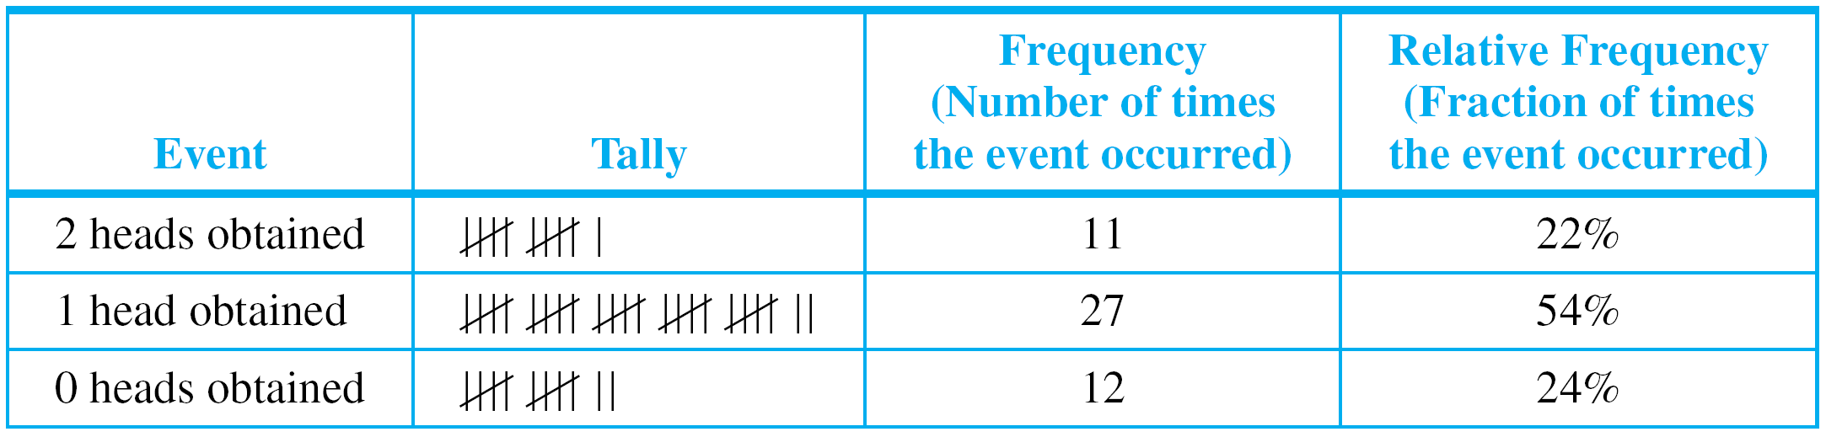
Introduction
Imagine tossing two coins and observing whether 0, 1, or 2 heads are obtained. It would be natural to guess that each of these events occurs about one-third of the time, but in fact this is not the case.
Table 9.1.1 below shows actual data obtained from tossing two quarters 50 times.
Experimental Data Obtained from Tossing Two Quarters 50 Times
Table 9.1.1

Slide 4
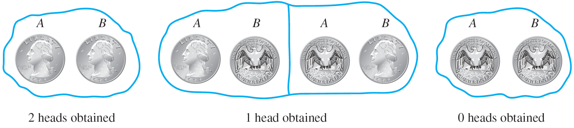
Introduction
Figure 9.1.2 shows that there is a 1 in 4 chance of obtaining two heads and a 1 in 4 chance of obtaining no heads.
The chance of obtaining one head, however, is 2 in 4 because either A could come up heads and B tails or B could come up heads and A tails.
Equally Likely Outcomes from Tossing Two Balanced Coins
Figure 9.1.2

Slide 5
Introduction
So if you repeatedly toss two balanced coins and record the number of heads, you should expect relative frequencies similar to those shown in Table 9.1.1.
To formalize this analysis and extend it to more complex situations, we introduce the notions of random process, sample space, event and probability.
Experimental Data Obtained from Tossing Two Quarters 50 Times
Table 9.1.1

Slide 6
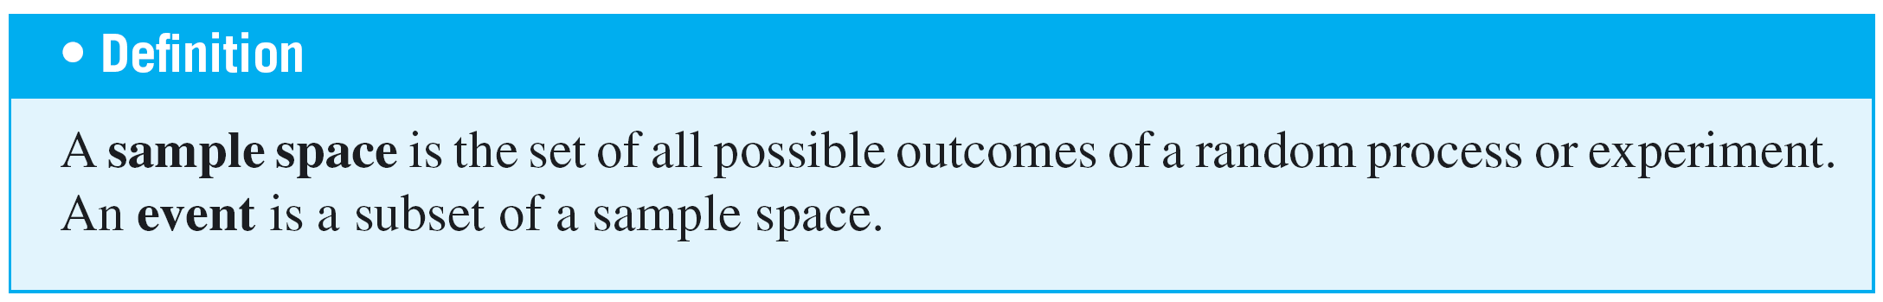
Introduction
To say that a process is random means that when it takes place, one outcome from some set of outcomes is sure to occur, but it is impossible to predict with certainty which outcome that will be.
In case an experiment has finitely many outcomes and all outcomes are equally likely to occur, the probability of an event (set of outcomes) is just the ratio of the number of outcomes in the event to the total number of outcomes.

Slide 7
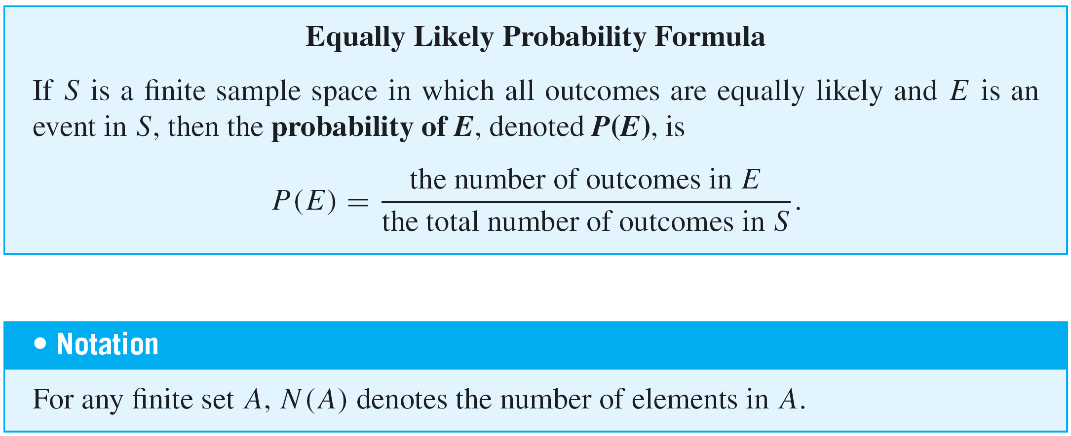
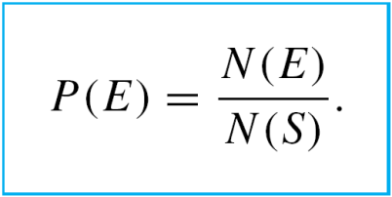
Introduction
With this notation, the equally likely probability formula becomes

Slide 8
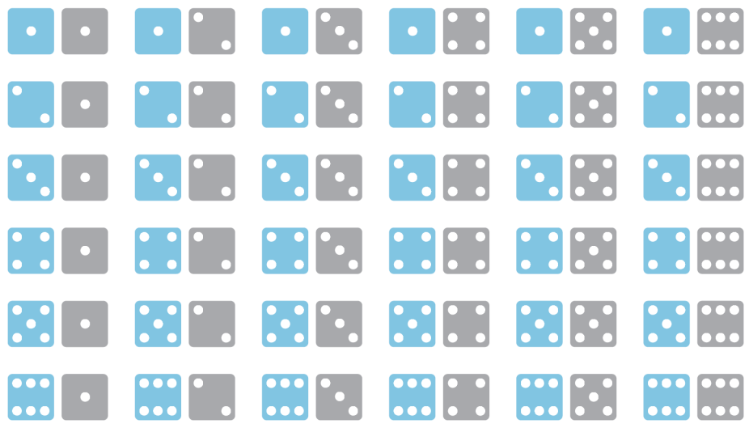
Example 2 – Rolling a Pair of Dice
A die is one of a pair of dice. It is a cube with six sides, each containing from one to six dots, called pips. Suppose a blue die and a gray die are rolled together, and the numbers of dots that occur face up on each are recorded.
The possible outcomes can be listed as follows, where in each case the die on the left is blue and the one on the right is gray.

Slide 9

Example 2 – Rolling a Pair of Dice
cont’d
A more compact notation identifies, say, with the
notation 24, with 53, and so forth.
a. Use the compact notation to write the sample space S of
possible outcomes.
b. Use set notation to write the event E that the numbers
showing face up have a sum of 6 and find the probability
of this event.

Slide 10
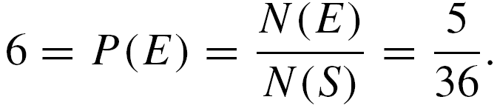
Example 2 – Solution
a. S = {11, 12, 13, 14, 15, 16, 21, 22, 23, 24, 25, 26, 31, 32, 33, 34, 35, 36, 41, 42, 43, 44, 45, 46, 51, 52, 53, 54, 55, 56, 61, 62, 63, 64, 65, 66}.
b. E = {15, 24, 33, 42, 51}.
Let P(E) be the probability of the event of the numbers
whose sum is 6.

Slide 11
Counting the Elements of a List

Slide 12
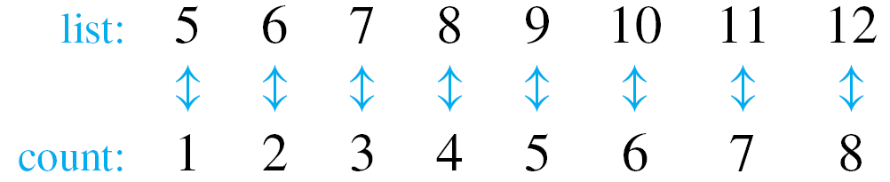
Counting the Elements of a List
Some counting problems are as simple as counting the elements of a list.
For instance, how many integers are there from 5 through 12? To answer this question, imagine going along the list of integers from 5 to 12, counting each in turn.
So the answer is 8.

Slide 13
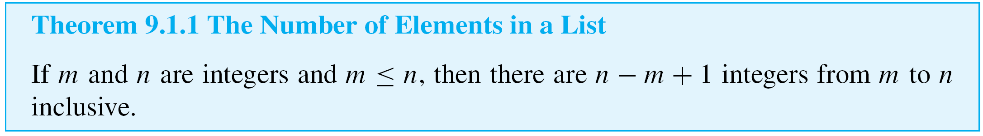
Counting the Elements of a List
More generally, if m and n are integers and m ≤ n, how many integers are there from m through n ? To answer this question, note that n = m + (n – m), where n – m ≥ 0
[since n ≥ m].

Slide 14
Example 4 – Counting the Elements of a Sublist
a. How many three-digit integers (integers from 100 to 999
inclusive) are divisible by 5?
b. What is the probability that a randomly chosen
three-digit integer is divisible by 5?
Solution:
a. Imagine writing the three-digit integers in a row, noting
those that are multiples of 5 and drawing arrows
between each such integer and its corresponding
multiple of 5.

Slide 15
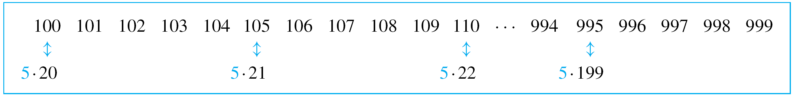
Example 4 – Solution
cont’d
From the sketch it is clear that there are as many
three-digit integers that are multiples of 5 as there are
integers from 20 to 199 inclusive.
By Theorem 9.1.1, there are 199 – 20 + 1, or 180, such
integers.
Hence there are 180 three-digit integers that are divisible
by 5.

Slide 16
Example 4 – Solution
cont’d
b. By Theorem 9.1.1 the total number of integers from 100 through 999 is 999 – 100 + 1 = 900. By part (a), 180 of these are divisible by 5.
Hence the probability that a randomly chosen three-digit integer is divisible by 5 is 180/900 = 1/5.

